Slide 1
OpenPLC 經驗分享
Hsinghua

Slide 2
Agenda
OpenPLC Runtime 目錄結構
修改 OpenPLC Runtime Web UI
hardware_layer.cpp -> APS-SDK
編譯 .st
TO DO List

Slide 3
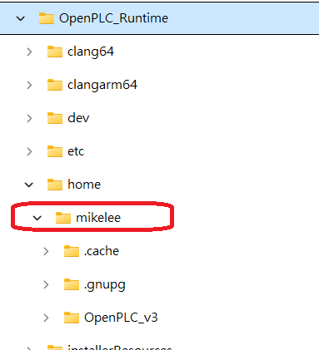
OpenPLC Runtime 目錄結構
請修改成你的 Windows 登入 id，否則執行 Runtime 時會誤判安裝不完整。

Slide 4
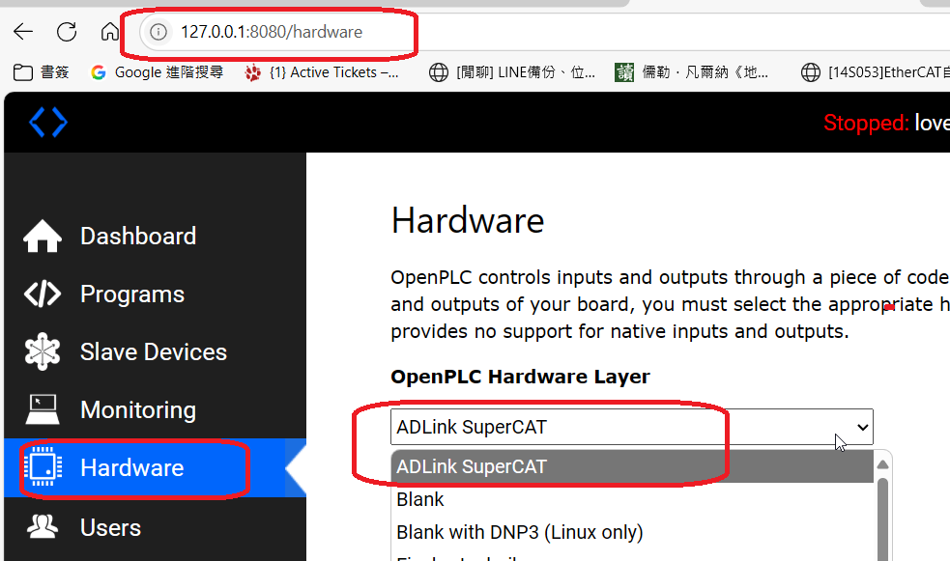
修改 OpenPLC Runtime Web UI 1/3

Slide 5
修改 OpenPLC Runtime Web UI 2/3
c:\OpenPLC_Runtime\home\mikelee\OpenPLC_v3\webserver\webserver.py

Slide 6
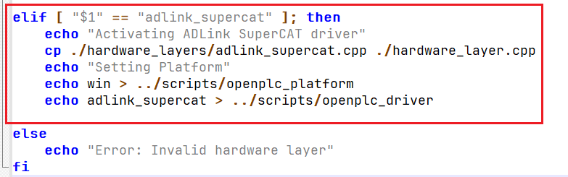
修改 OpenPLC Runtime Web UI 3/3
c:\OpenPLC_Runtime\home\mikelee\OpenPLC_v3\webserver\scripts\change_hardware_layer.sh

Slide 7
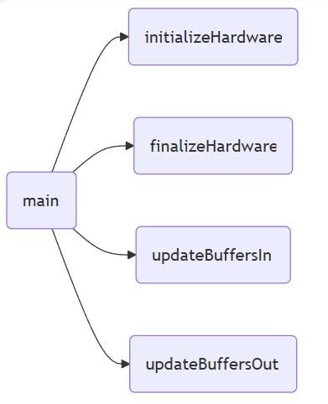
hardware_layer.cpp -> APS-SDK 1/7
hardware_layer.cpp
ADLINK APS-SDK

Slide 8
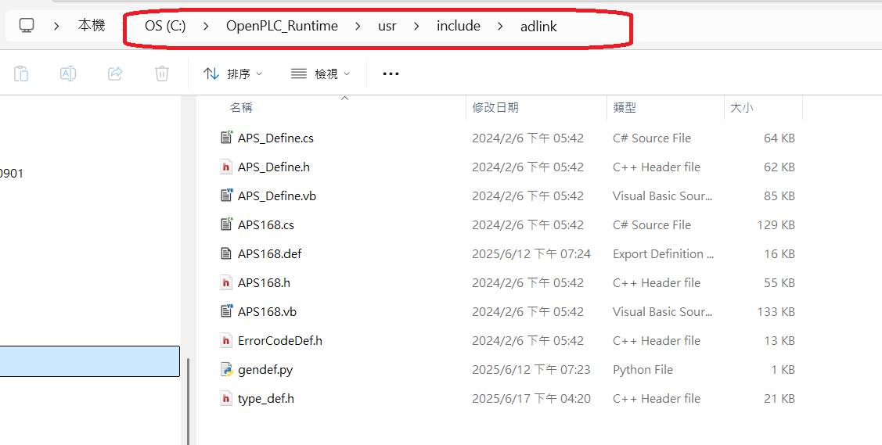
hardware_layer.cpp -> APS-SDK 2/7

Slide 9
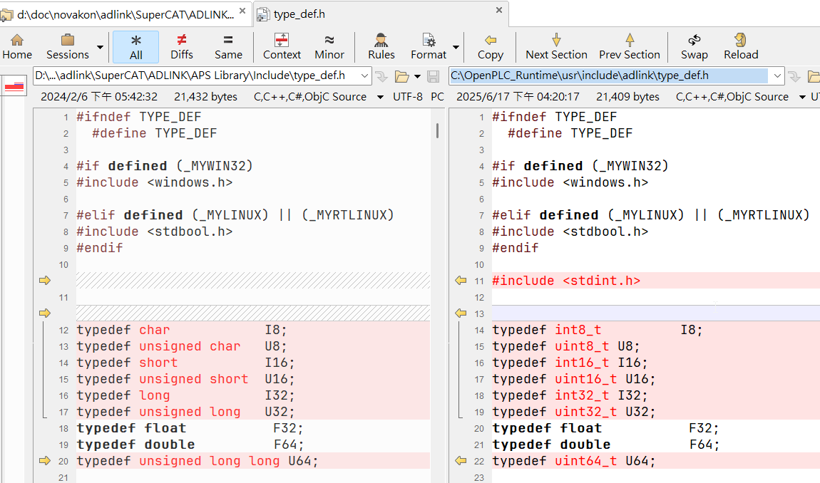
hardware_layer.cpp -> APS-SDK 3/7

Slide 10
hardware_layer.cpp -> APS-SDK 4/7
APS168.h -> chatGPT -> APS168.def
dlltool -d APS168.def -l libAPS168x64.a

Slide 11
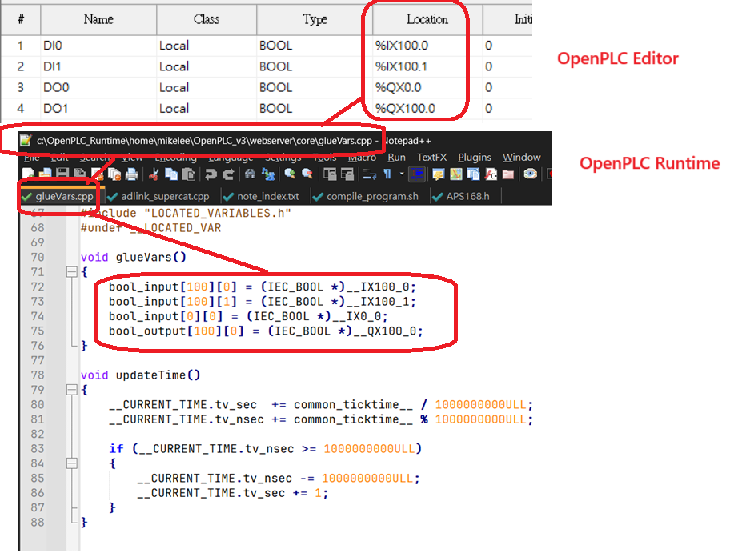
hardware_layer.cpp -> APS-SDK 5/7

Slide 12
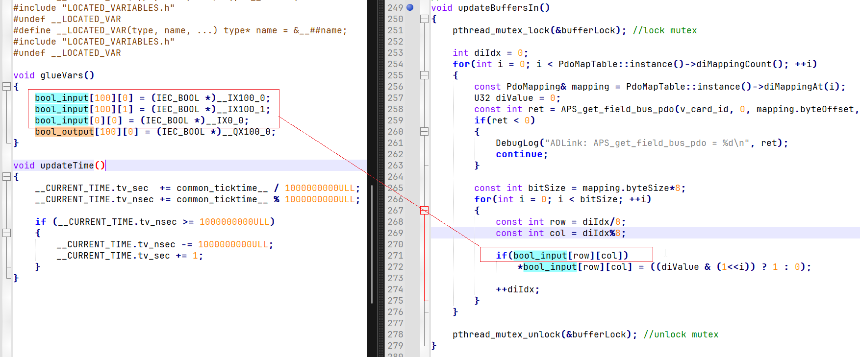
hardware_layer.cpp -> APS-SDK 6/7

Slide 13
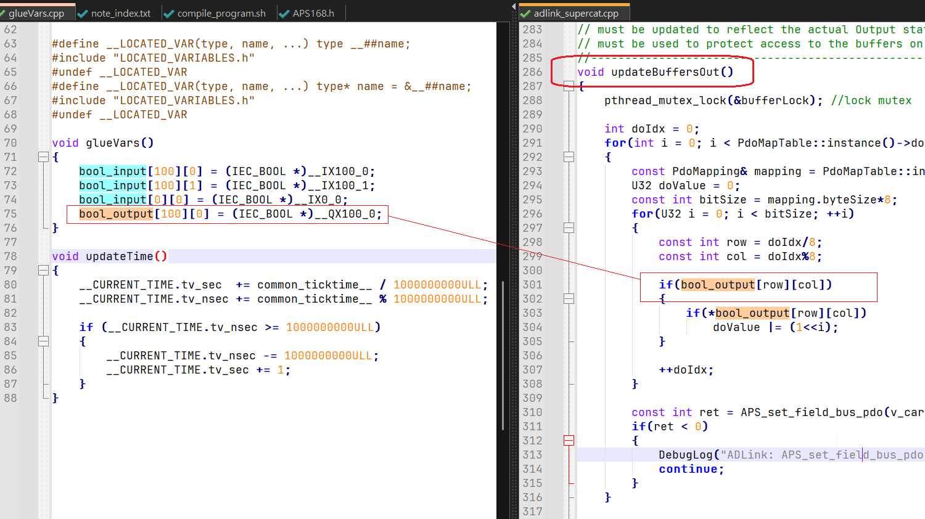
hardware_layer.cpp -> APS-SDK 7/7

Slide 14
編譯 .st
c:\OpenPLC_Runtime\home\mikelee\OpenPLC_v3\webserver\scripts\compile_program.sh
g++ *.cpp *.o -o openplc -I ./lib -pthread -fpermissive -I /usr/local/include/modbus -I /usr/local/include/adlink -L /usr/local/lib snap7.lib -lmodbus -lAPS168x64 -w

Slide 15
TO DO List
iFACE SCADA RT <-> OpenPLC Runtime
Special Modbus TCP Server
Function Block <-> C API
Import EtherCAT I/O Mapping to OpenPLC variables

